Slide 1

Hospital Management System

Slide 2
Team Members are:
Deepti Singh
Dhivyaadarshini Sa
Dasari Naga Lakshmi
Gavvala Nikhil
Gokul Ravichandran
Guddeti Venkata Yogananda Reddy
Gurram Harshavardhan
J Priya
Jayaprabha K
K Gokulaprasad

Slide 3
OBJECTIVE:
Main objectives of a Hospital Management System are to design a system for better patient care.Reduce hospital operating costs, so it helps prevent some of these expenses by automating bureaucratic process such as inventory and laboratory management, as well as patient registration. With the introduction of HCM in the hospital, the customer experience will improve by default. As a result, the process of registration, appointments, monitoring the doctors’ schedule, obtaining result, and much more are digitized.

Slide 4
Introduction :
The project Hospital Management system includes registration of patients, storing their details into the system, and also computerized billing. The software has the facility to give a unique id for every patient and stores the details of every patient and the staff automatically. It includes a search facility to know the current status of each appointment. Users can search the availability of a doctor and the details of a patient using the id. The Hospital Management System can be entered using a username and password. It is accessible by an administrator. Only they can add data into the database. The data can be retrieved easily. The interface is very user-friendly. The data are well protected for personal use and make the data processing very fast. Hospital Management System is powerful, flexible, and easy to use and is designed and developed to deliver real conceivable benefits to hospitals. Hospital Management System is designed for multispeciality hospitals, to cover a wide range of hospital administration and management processes. It is an integrated end-to-end Hospital Management System that provides relevant information across the hospital to support effective decision-making for patient care, hospital administration, and critical financial accounting, in a seamless flow. Hospital Management System is a software product suite designed to improve the quality and management of hospital management in the areas of clinical process analysis and activity-based costing. Hospital Management System enables you to develop your organization and improve its effectiveness and quality of work. Managing the key processes efficiently is critical to the success of the hospital helps you manage your processes.

Slide 5
Software Requirements:
This section describes the software requirements of the system.
Windows 10
MYSQL (Version-8)
VSCODE (Version-1.67.2)
Angular (Version-13.3.1)
Spring-Boot

Slide 6
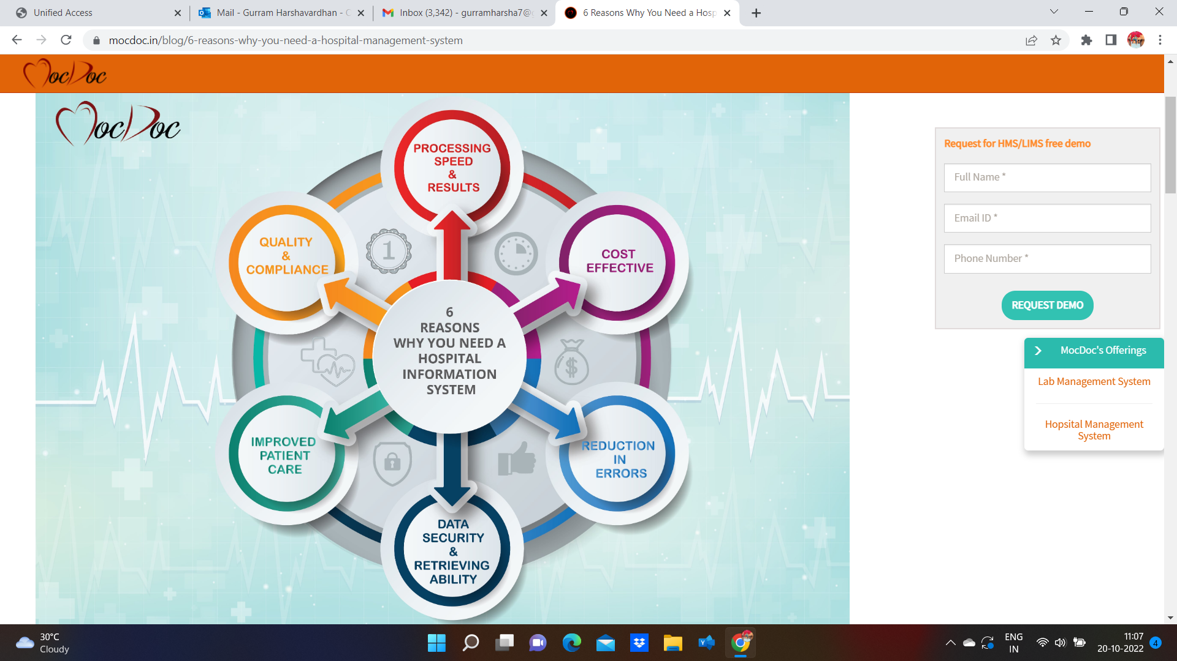
Why Hospital System :

Slide 7
Advantages of Hospital Management System :
Specifically, the integration of the software into the system has made communication much more effective in the case of the health care system. As a result, it is possible to access every data from anywhere in the world specifically via. authorized login. This mode of communication has become relatively cheaper.
The effective usage of technology has contributed to minimizing many of the limitations. One of the biggest issues in the health care system is considered to be the geographical limitation.This has been effectively managed with the addition of the hospital management system. The integral reports can be sent through instant messages, emails, etc.
In the case of the hospital management system, the information is available 24 hours throughout the week. This indicates that the reports can be sent anytime on any particular day.So, there is no such possibility for the delay in getting the treatment. Apart from that, the communication mode has become relatively cheaper. Therefore, no report will be delayed from reaching the hands of the authorities.
Improved productivity and cost-effectiveness is considered to be another important advantage of the hospital management system. Currently, it has been productive to manage the things automatically when compared to the old day manual set up.
In recent days, many of the modifications are brought to the specific system. One of the integral things is considered to be the change in the education system. This has ultimately given shape to a completely new type of system.

Slide 8
Disadvantages of Hospital Management System :
One of the greatest disadvantages of the hospital management system is generally related to security. It is considered to be a matter of concern in case you go online without enough protection which can create some big problems related to security.
Another greatest problem that is associated with the health care industry is the data breach. Not only that, but it is also known to be a sophisticated problem.
Lack of employment is another such thing. The chances of employment usually become less with the automation of the system. Also, the gradual need for manual data drafting becomes an irrelevant aspect.

Slide 9
Login and Registration Module
Login and Registration is required for Admin, Doctor and Patient.
We are using spring to handle the backend and angular for frontend.
Testing is done using selenium web driver
Admin Login and Registration
In the backend we have the entity class , service class , repository and controller for the admin Login and Registration.
Dependencies are added in pom.xml file and given the details of database in the application.properties file

Slide 10
Login and Registration Module
Angular project is created for frontend where we have two components (admin-login , admin-signup)
Importing necessary modules and routing are done.
We have a class and service class for admin.
Login and SignUp pages are created using angular forms.

Slide 11
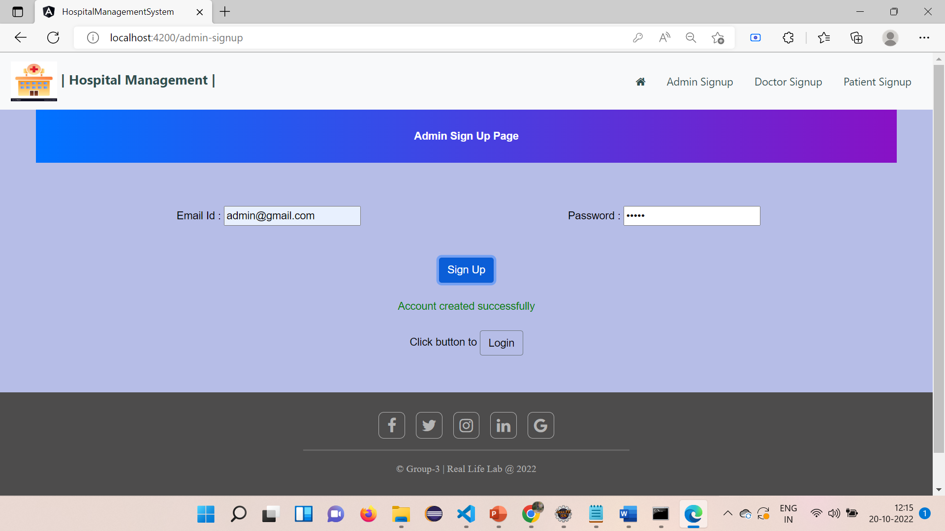
Admin Sign Up Page

Slide 12

Admin Sign Up Page

Slide 13
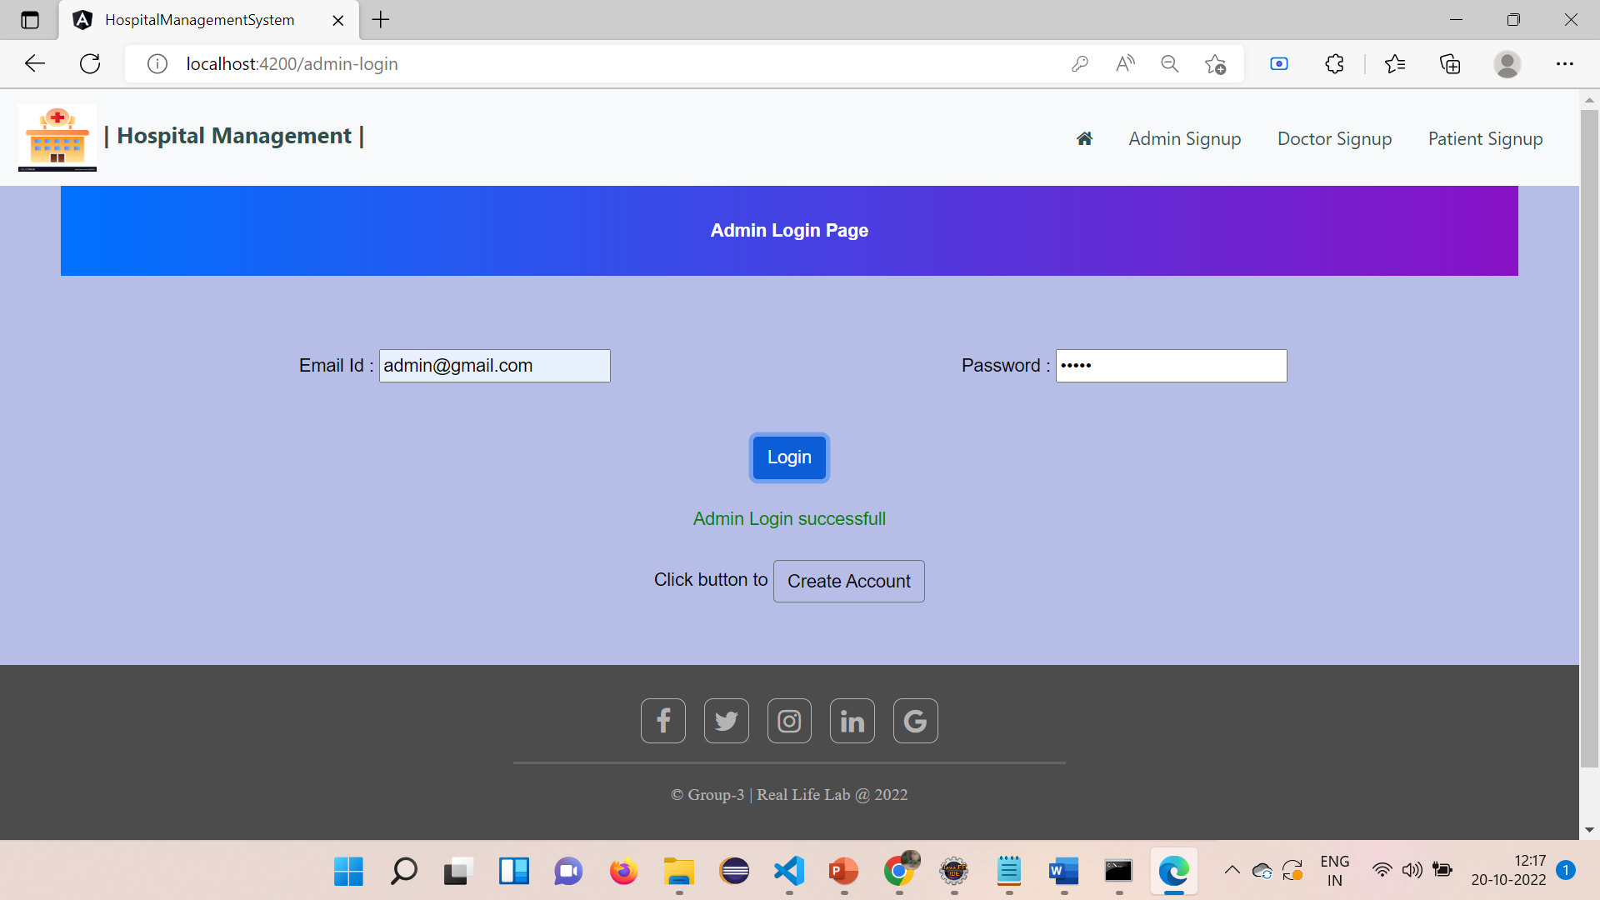
Admin Login Page

Slide 14

Admin Login Page

Slide 15

Admin Login Page

Slide 16
Login and Registration Module
Login and Registration for Doctor and Patient
Springboot project is created for doing the backend there we have the entity class , service class , repository and controller for the Login and Registration of doctor as well patient.
Database details are provide in the application.properties and the necessary dependencies are added in pom.xml file.

Slide 17
Login and Registration Module
In the angular project (frontend) two components are created for login and signup in which for both doctor and patient login and registration is done
Importing necessary modules and routing are done.
Login and SignUp page are developed using angular model driven form and the functions for the login and signup are written in their corresponding ts file.
There is one common class and service class for both doctor and patient.

Slide 18
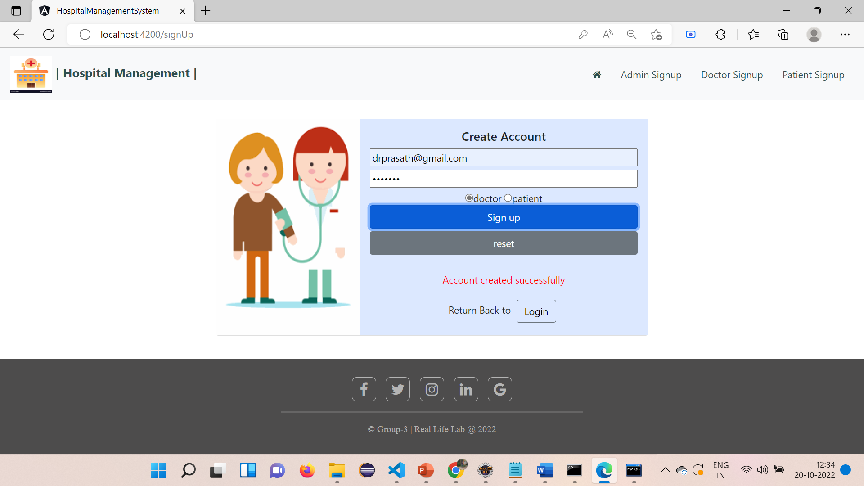
Doctor Sign Up Page

Slide 19
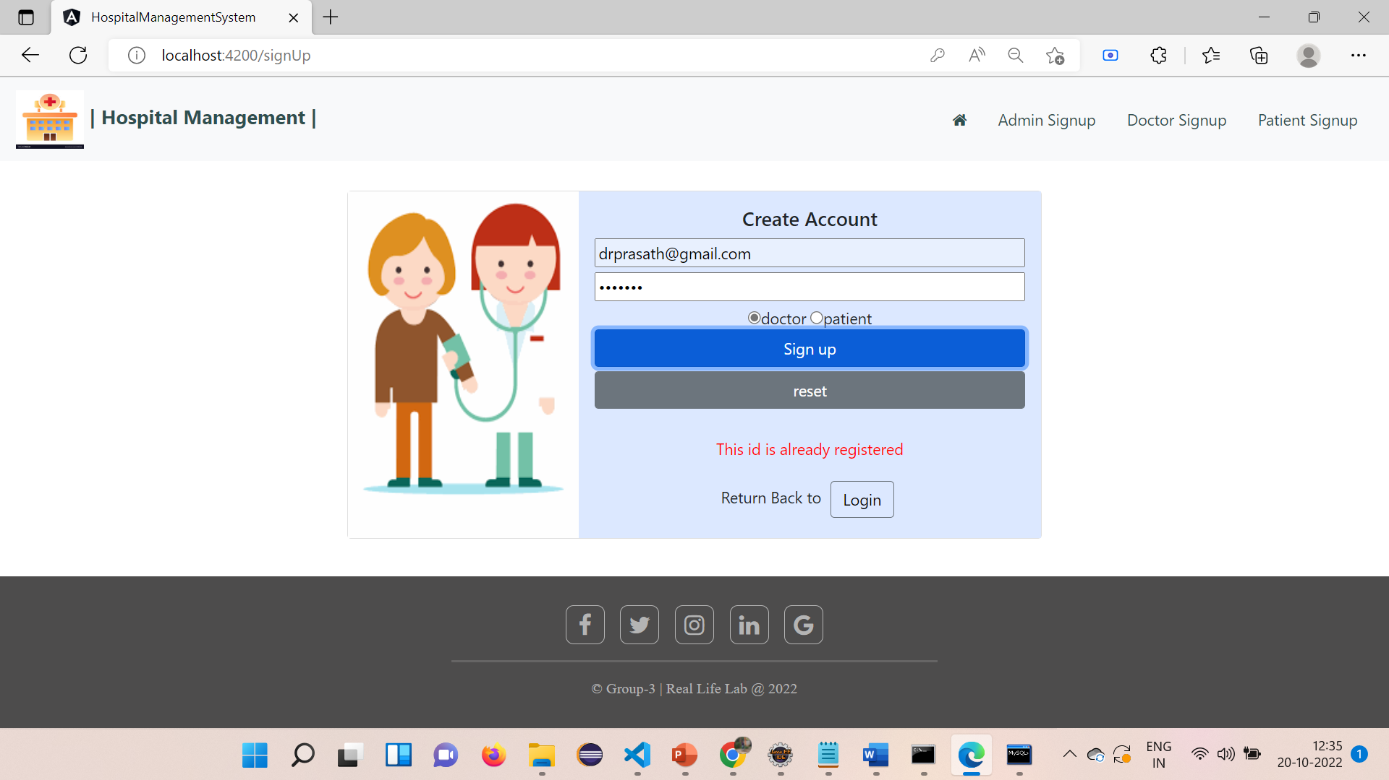
Doctor Sign Up Page

Slide 20
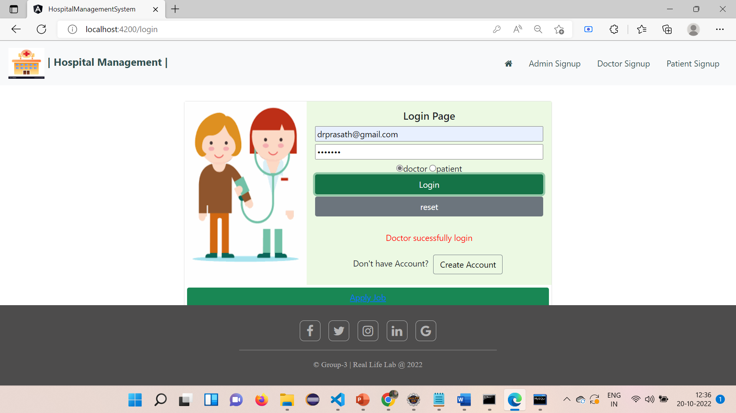
Doctor Login Page

Slide 21

Doctor Login Page

Slide 22
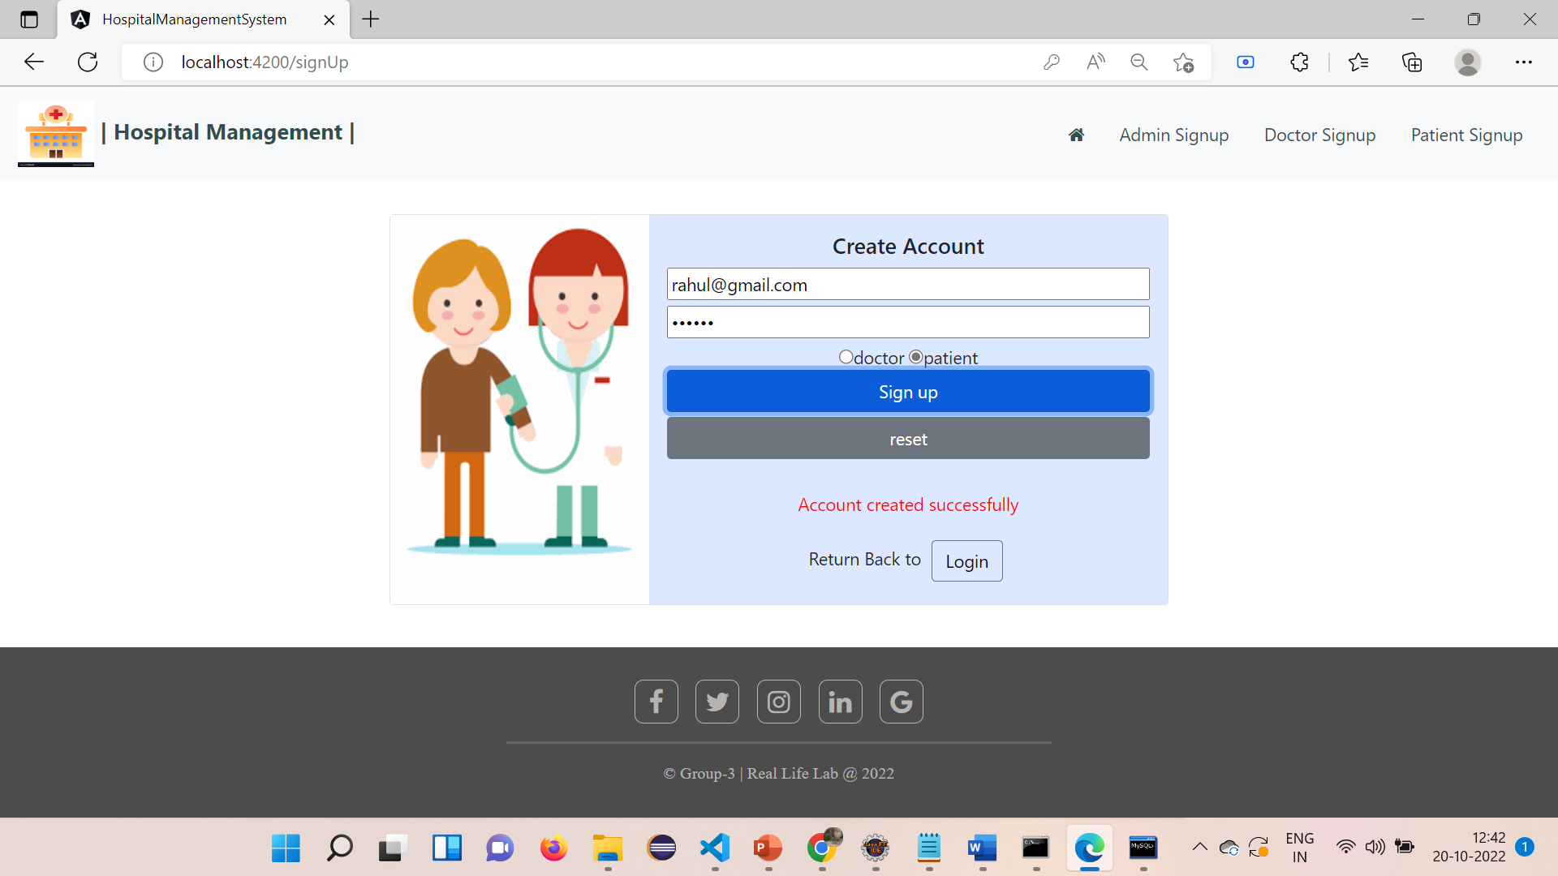
Patient Sign Up Page

Slide 23

Patient Sign Up Page

Slide 24

Patient Login Page

Slide 25

Patient Login Page

Slide 26
Admin Module
Admin holds the keyrole in the Hospital Management System
the key responsibilities and functionalities to be implemented by Admin are:
The admin module can register, view, reject, delete and approve those doctors who applied for job in their hospital.
Admin can admit, view, approve, reject and discharge patient when treatment is done.
Can generate and download Invoice according to medicine cost, room charge, doctor charge and other charge.
Can view, book, approve Appointment from patient.

Slide 27
Admin Modules
Admin and doctor Relationship:
As you know the admin need to control the entire hospital management system, as expected there will be the relationship between admin and doctor
Doctor: In this section the admin manages the doctor
The manages are meant to appoint the doctor
To reject the doctor if there’s any problem with doctor
And we can even reject the doctor if we don’t like the application

Slide 28
Admin Modules contd.
View Doctor List:
In this section the admin can view the list of the doctors
He can see the entire database of every doctor in the view Doctor list
You can see the specialization of the doctor if we want to assign the doctor to a patient
For convenience purpose we added the apply for doctor option in the admin if he want to consult the admin and fill his application.
The registration of doctor can be done in admin also.

Slide 29
Admin Modules contd.
approve those doctors who applied for job in the admin
To approve the doctor we added a button in the view doctors list
This function is done in a way that when the admin wanted to appoint or recruit a doctor and clicks the approve button then it updates the pending to approved in the database
And it reflects in the view Doctor list
In this way the Doctor is approved.
If the admin didn’t like the doctor and want to reject him then he can simply press the reject button and at the backend the pending status will be converted into rejected

Slide 30
Admin Modules contd.
Then the backend updates the database as “rejected” the doctor
But we made the view Doctor List to show the doctor even we rejected because if there’s any need we can approve them again
If we definitely we want to delete the person then we added a delete button
This delete button has given the delete function and deletes the entire database of the particular doctor
In this way the doctor module is controlled in admin

Slide 31
Admin modules contd.
Admin and Patient Relationship:
View Patient List:
In this we gave to viewPatient function to fetch all the details of the Patients
The patient need to be approved by the admin first
To admit the patient we created the admit button in the viewPatientList to admit the patient or not
Or if the hospital doesn’t have the specific doctors to deal with problem of the patient we have reject button to reject the patient

Slide 32
Admin Module contd.
When the admin clicks on the admit button the backend updates the database of the patient
Where the pstatus (or) patient Status updated as admitted .
In this way the admin can see the status in the viewPatientList and move further
In the same way if he want to reject the he clicks the reject button and the backend updates the database status as rejected.

Slide 33
Admin Module contd.
If the admin want to entirely discharge the patient then the admin can enter the consulted page
But before this the patient need to assigned to doctor
DischargePatient Details
For that the patient is gonna have an appointment.
After the patient is approved for checkup
The admin needs to plan an appointment for the patient
So he assigns the doctor to the patient by checking the respective specialization and disease of the doctor
And assigns the patient to the doctor

Slide 34
Admin Module contd.
This appointing will be done after admitting.
Then once the doctor is consulted with the patient
From the doctor module the database is updated as “consulted “ and the patient appears in the discharge section.
Then the admin can simply discharge the patient by clicking on the discharge patient button.

Slide 35
Admin Module contd.
createInvoice
In this we create invoice for the patient who are consulted with the doctor
Here we give all the details of the patient and click the create invoice
And can give it to the patient
And we can discharge the patient and generating the invoice
These are the controls for the admin.

Slide 36
DOCTOR MODULE:
Key functions:
Doctor can Login and Signup .
Doctor can see the patient list.
Doctor can see the Appointment List and Discharge List.
Doctor can DELETE the Appointment.

Slide 37
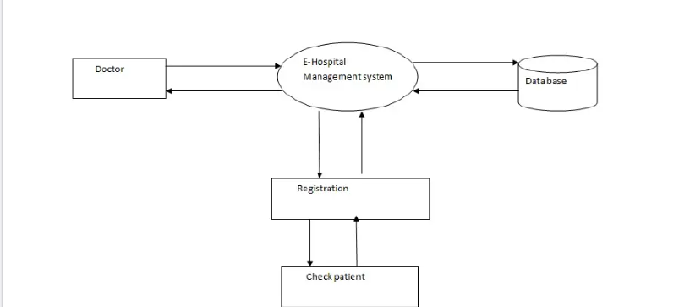
DOCTOR FLOW DIAGRAM:

Slide 38
DESCRIPTION- The doctor view patients and discharge the patients.
PRE-CONDITION – The doctor must be a registered doctor. Admin should approve the doctor application.
MAIN FLOW OF EVENTS
1. Doctor logs in to the system.
2. Doctor may select view patient.
2.1 Patient record is displayed with symptoms.
3. Doctor can view appointment details
3.1 Appointment Requests is displayed with discharged button.
4. Doctor can delete the appointment.
POST CONDITION – The patient and doctor ‘s database are updated.

Slide 39
View Discharged Patients
Job Application
View Appointments
SignIn
DOCTOR
View Patient
SignUp

Slide 40
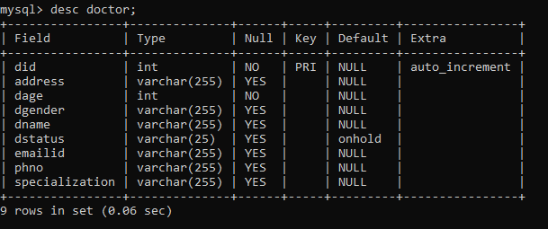
DOCTOR DATABASE:

Slide 41
Apply job:
Doctor details are taken as input from form.
Through service using http client backend function is called by passing doctor object.
The backend is responsible for saving doctor details.
View id:
The doctor can get his id by providing email as input.
The backend returns doctor id if his application is approved.
Doctor Dashboard:
In doctor dashboard, buttons are provided to navigate to the functions he need to perform.

Slide 42
Save id:
The doctor can save his id which can be used for further functions he need to be performed.
View patient:
The doctor can view patients list assigned to him.
View appointments:
The doctor can view patients list whom he needs to consult which was appointed by admin.
The doctor can also delete his consulted patients from the table.
Discharge patient:
The doctor can view his discharged patients which was done by admin.

Slide 43
Patient
Introduction:
The hospital management system helps register complete patient information. It captures and stores the medical history, treatment required, details of their previous visits, upcoming appointments if any, reports, insurance details and more. It helps eliminate the need to get these details on every visit. This enables the doctor to focus more on the treatment and improves the patient experience.When patients book an appointment, Hospital Management System assigns them to the specialist available, or the one that they prefer. For assignment, it matches the patient’s illness to the doctor’s area of expertise. If medical care needs to be provided at the patient’s house, the system will check the doctors’ availability for the remote visit. Again, the allocation happens based on availability.

Slide 44
Patient Modules:
Key Functions:
Patient can login and signup
Patient can book appointments
patient can view their appointment status

Slide 45
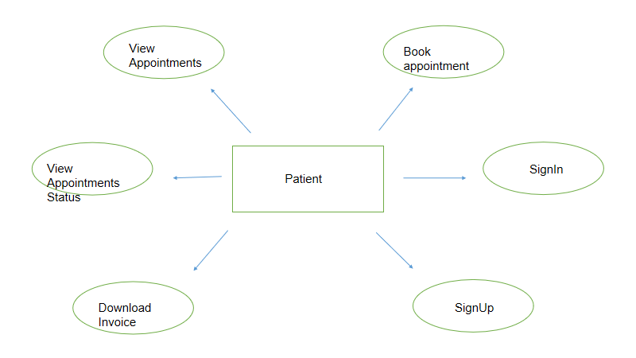

Slide 46
Description: The Patient can book appointments and can view the appointment Status
PRE-CONDITION : The patient must be a registered patient. Admin should approve the patient application.
Patient Flow : patient have to create account for admit in hospital.
By using the credentials the patient can jump into patient portal.
After that there is a option called book appointment by using the option patient can book the appointment.
Patient can view the appointment status.
Patient can view/download invoice pdf(only when patient is discharged by admin)
POST CONDITION : The patient database are updated.

Slide 47
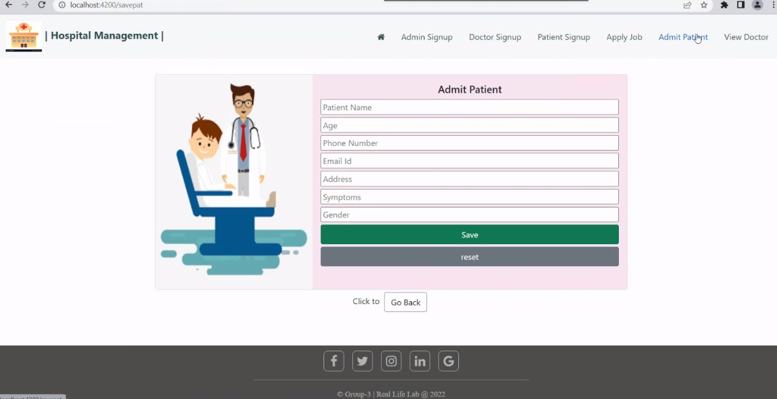

Slide 48
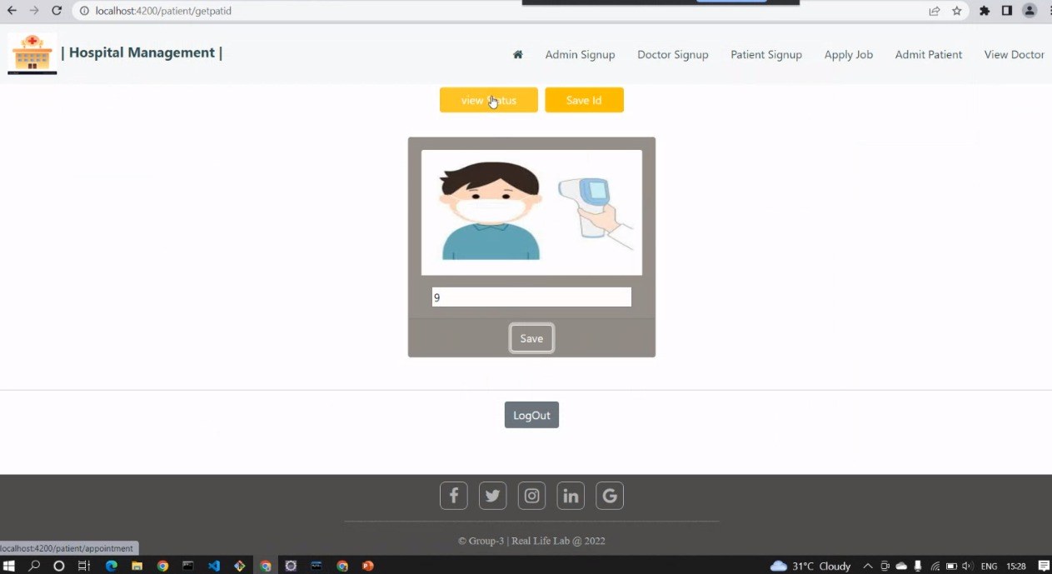

Slide 49
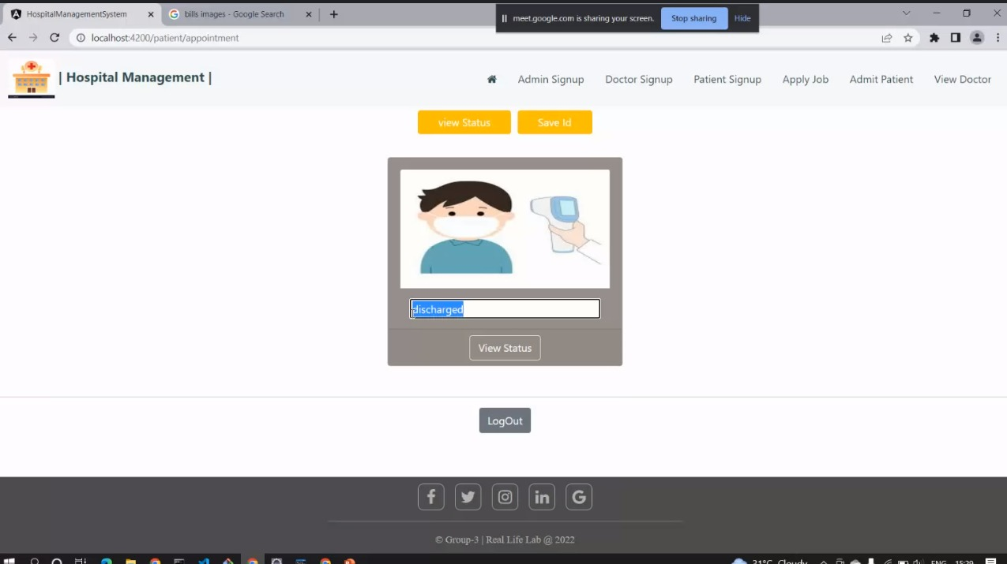

Slide 50


